Slide 1

Artificial Neural Networks
Payam Barnaghi
Department of Brain Sciences &
School of Convergence Science (Human and Artificial Intelligence)
Imperial College London
January 2026
Notes:
1

Slide 2
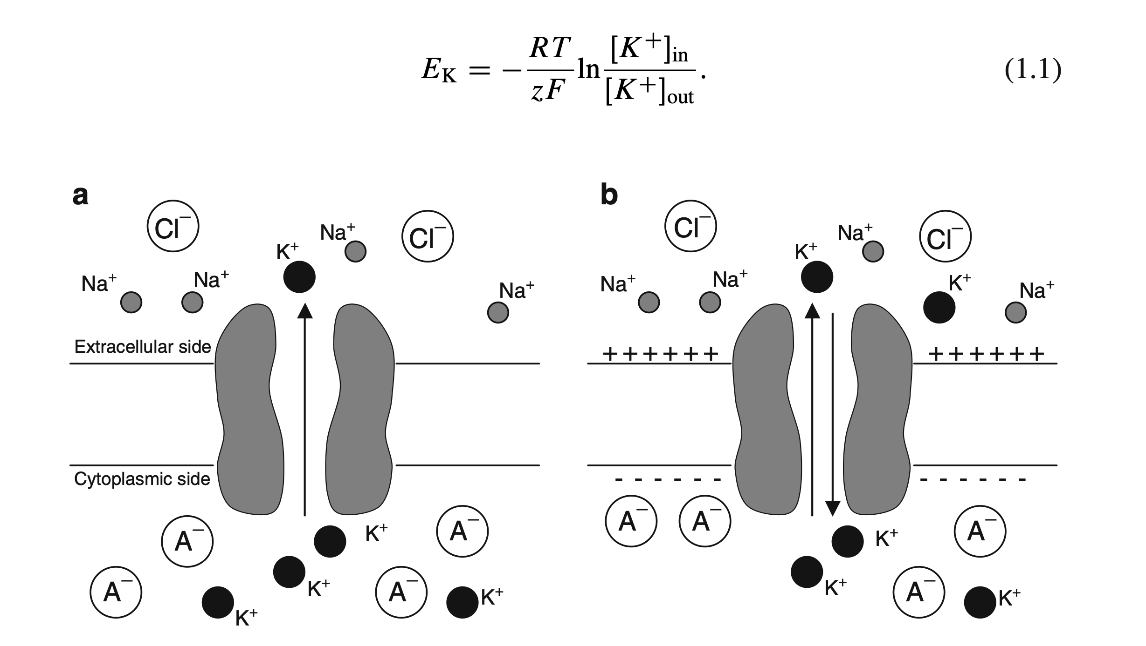
Hodgkin-Huxley neuron model
This is a computational model of a biological neuron; in contrast, in ML, we are interested in modelling an artificial neuron that can help us to solve (machine) learning and decision-making problems.
Image from: http://www.math.pitt.edu/~bdoiron/assets/ermentrout-and-terman-ch-1.pdf
Notes:
Here, EK is the KC Nernst potential, R is the gas constant, T is the absolute temperature in kelvin, z is the valence of KC, F is Faraday’s constant, and ŒKCout and ŒKCin are the concentrations of KC ions outside and inside the cell. A similar formula holds for the NaC and Cl Nernst potentials.

Slide 3
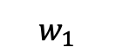
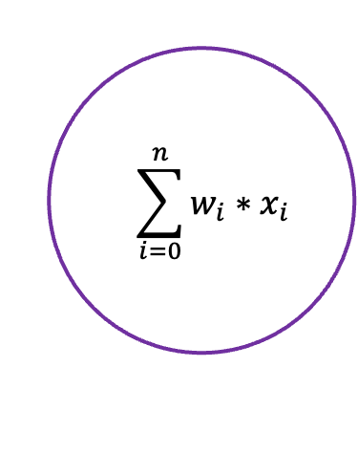
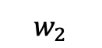
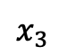
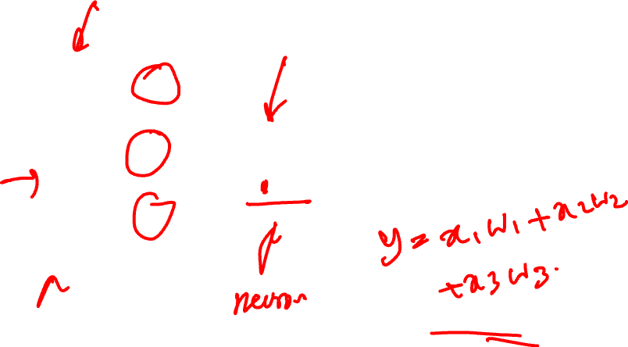
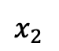
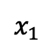
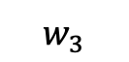
Artificial Neuron
$$x_{1}$$
$$w_{1}$$
$$=\sum_{i=0}^{n}{w_{i}{∗x}_{i}}$$
$$w_{2}$$
$$x_{2}$$
y
$$w_{3}$$
$$x_{3}$$

Slide 4
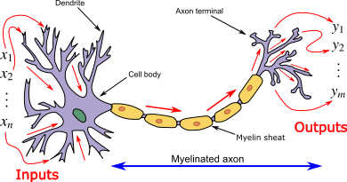
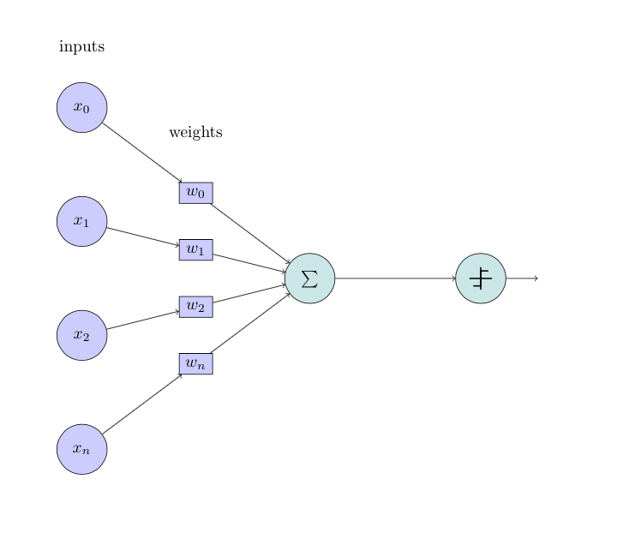
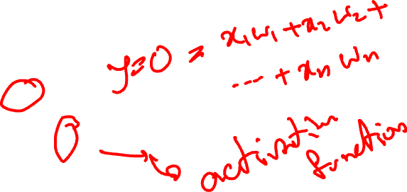
Artificial neuron vs biological neuron

Slide 5
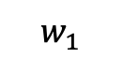
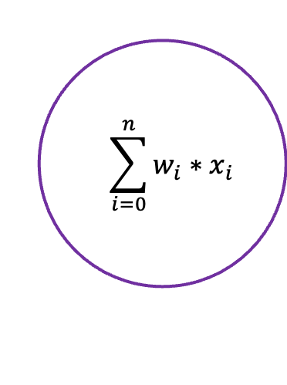
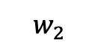
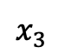
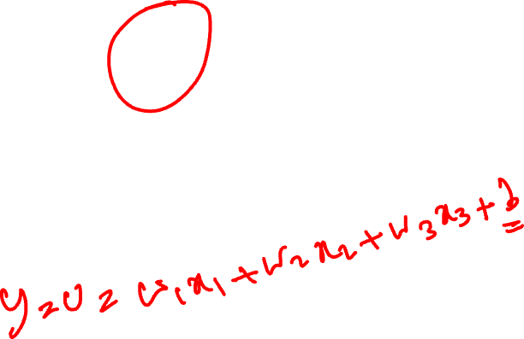
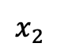
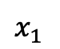
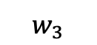
Artificial Neuron with Bias
b
$$x_{1}$$
$$w_{1}$$
$$=\sum_{i=0}^{n}{w_{i}{∗x}_{i}}$$
$$w_{2}$$
$$x_{2}$$
y
$$w_{3}$$
$$x_{3}$$

Slide 6
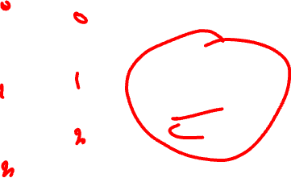
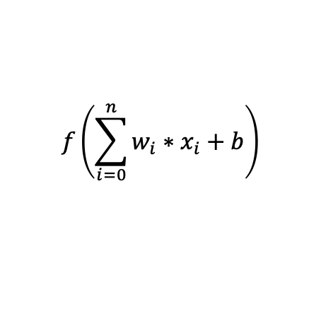
Artificial neurons and the effect of bias
b
$$x_{1}$$
$$w_{1}$$
$$w_{2}$$
$$f\left(\sum_{i=0}^{n}{w_{i}{∗x}_{i}}+b\right)$$
$$x_{2}$$
y
$$w_{3}$$
$$x_{3}$$

Slide 7
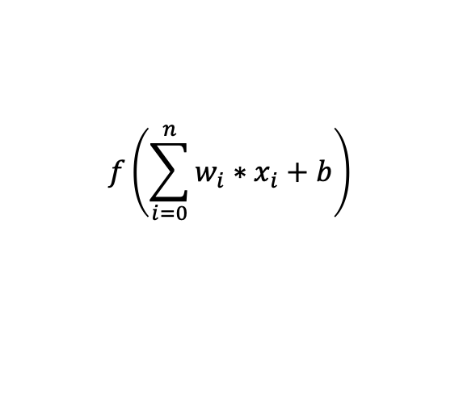
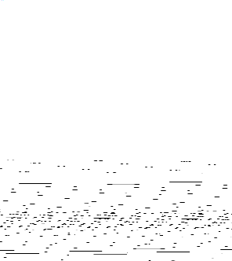
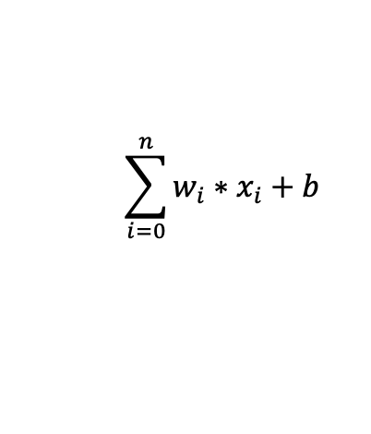
NN with an Activation Function
b
$$x_{1}$$
$$w_{1}$$
$$w_{2}$$
$$\sum_{i=0}^{n}{w_{i}{∗x}_{i}}+b$$
$$x_{2}$$
y
$$w_{3}$$
$$x_{3}$$
$$f\left(\sum_{i=0}^{n}{w_{i}{∗x}_{i}}+b\right)$$

Slide 8
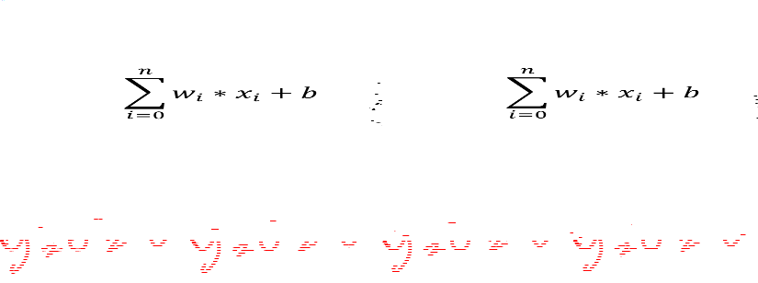
Limitations of linear models
Linearity implies the weaker assumption of monotonicity, i.e., that any increase in our feature must either always cause an increase in our model’s output (if the corresponding weight is positive) or always cause a decrease in our model’s output (if the corresponding weight is negative).
However, this assumption is not always true or helpful in real-world applications. For individuals with a body temperature above 37 °C (98.6 °F), higher temperatures indicate greater risk. However, this risk does not increase linearly when, for example, the body temperature drops below 37 °C or rises above 38.5 °C.

Slide 9
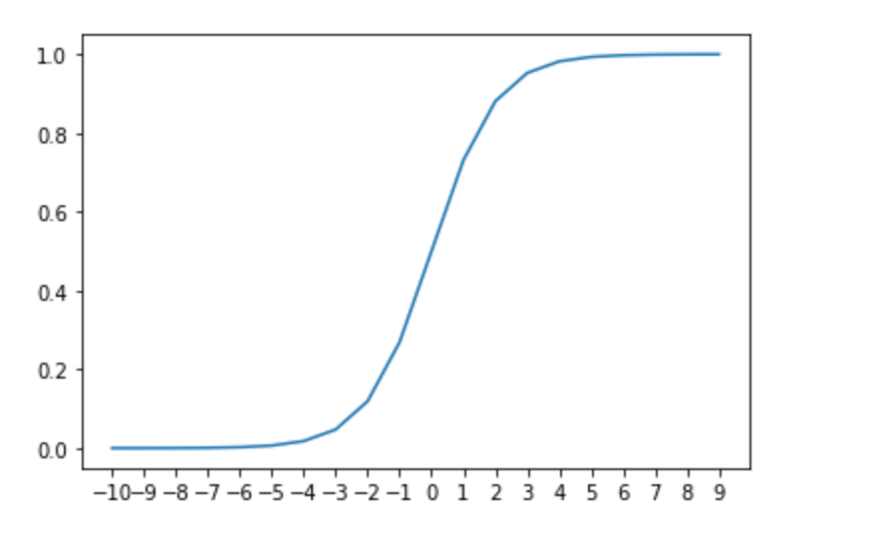
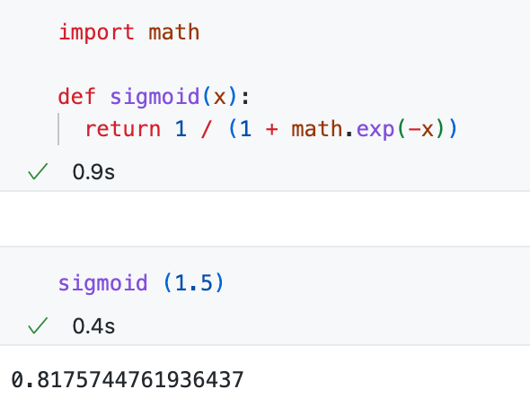
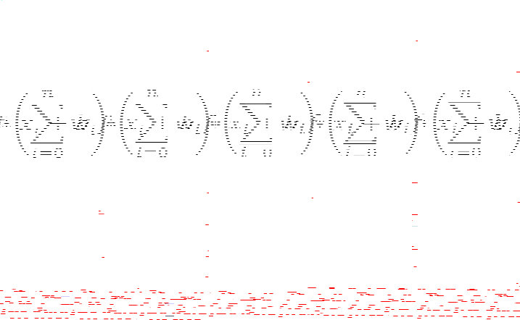
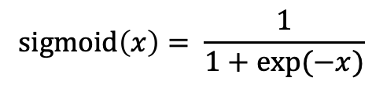
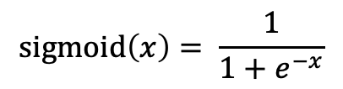
Sigmoid function
$$sigmoid\left(x\right)= \frac{1}{1+e^{−x}}$$
$$sigmoid\left(x\right)= \frac{1}{1+exp⁡(−x)}$$

Slide 10
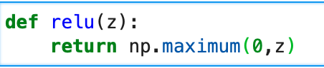
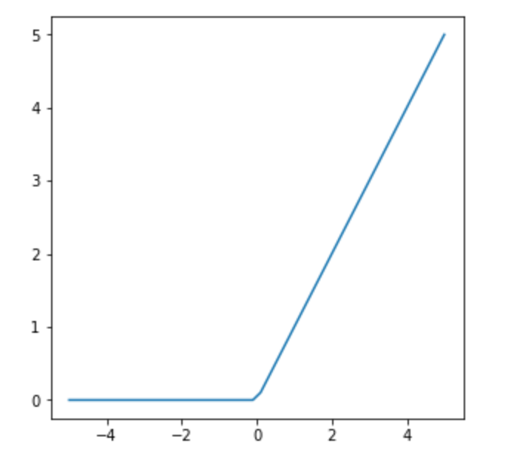

Rectified Linear Units (ReLU)

Slide 11
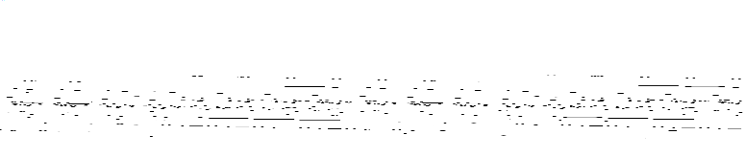
ReLU
The half rectifying nonlinearity simulates some of the properties of biological neurons:
For some inputs, biological neurons are completely inactive (sparse activation).
For some inputs, a biological neuron’s output is proportional to its inputs.
Most of the time, biological neurons operate in an inactive state (i.e., they have sparse activation).

Slide 12
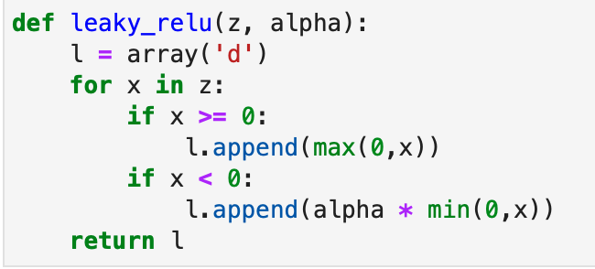
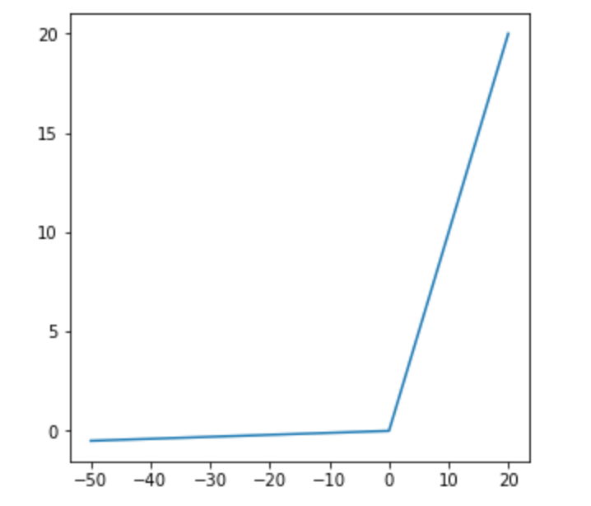
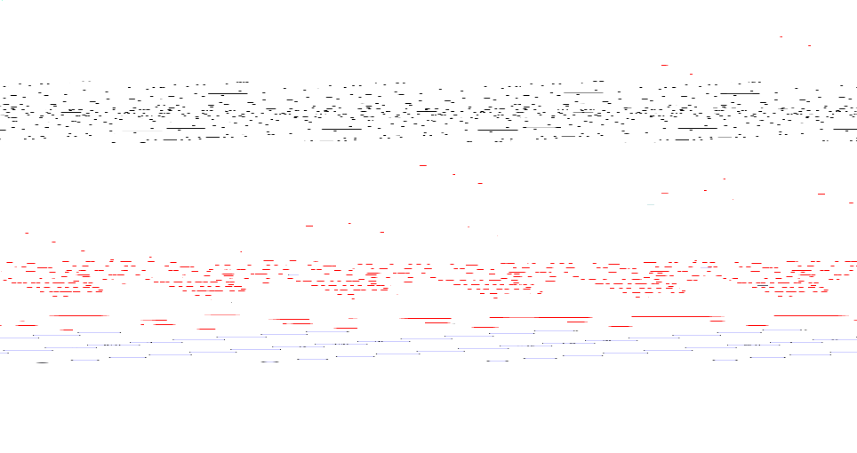
Leaky ReLU

Slide 13
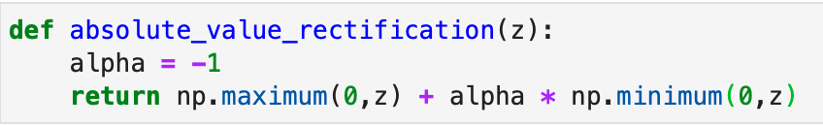
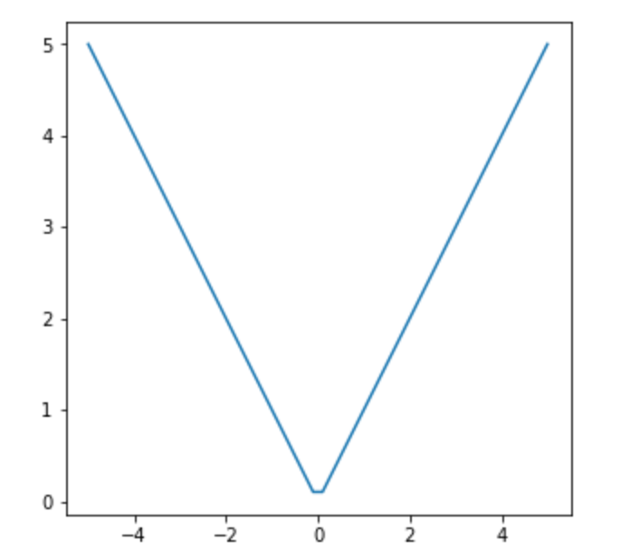

Absolute Value Rectification

Slide 14

Nonlinearity in machine problems
In the past lectures, we have seen that the decision space and feature representation in most machine learning problems are not linear.
So, the question is: how to add nonlinearity to neural network models?

Slide 15

Hidden layers
We can overcome the limitations of linear models by also incorporating one or more hidden layers (with activation functions).
The easiest way to do this is to stack several fully connected layers on top of each other.
Each layer feeds into the layer above it until the model generates outputs.
This architecture is commonly called a Multilayer Perceptron (MLP).

Slide 16
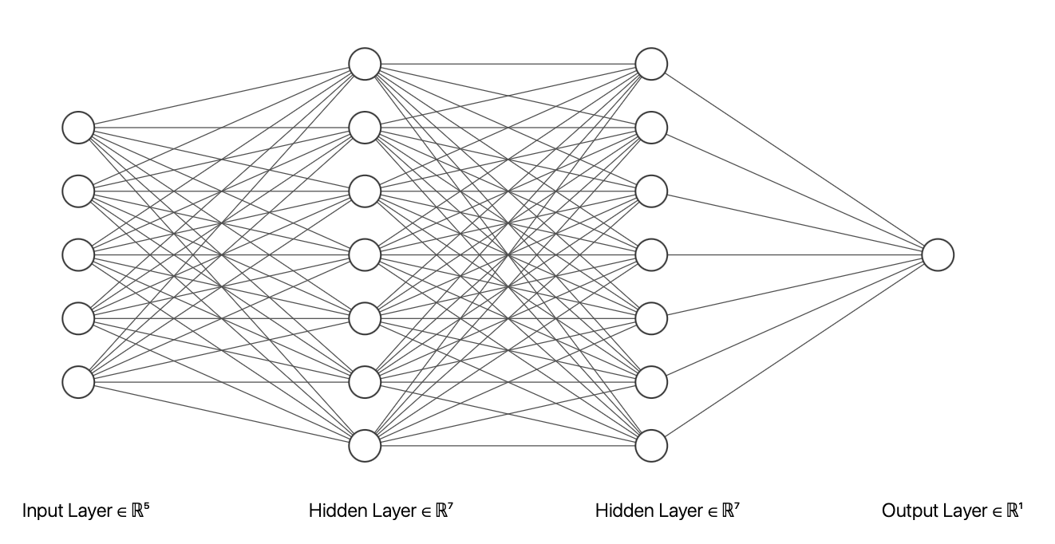
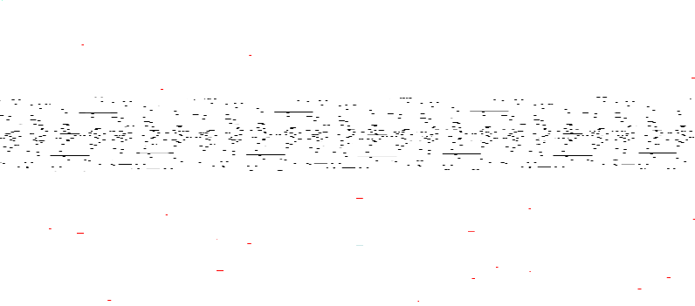
Multilayer perceptron architecture
The figure is drawn using: https://alexlenail.me/NN-SVG/

Slide 17

MLP architecture
We can think of the first L−1 layers as our representation and the final layer as our linear predictor.

Slide 18

Layers in a neural network
Input layer
Hidden layers
Output layer
The number of hidden layers determines the depth of the network. The term “deep learning” originates from this terminology.
The width of the network is determined by the number of nodes (dimensionality) in the hidden layer(s).

Slide 19

How neuroscience has inspired this model
The idea of using many layers of connected neurons and networks (here, they are very structurally connected).
The concept of using an activation function.
There are several more advanced architectures that mimic concepts from neuroscience, such as memory-based models (e.g., LSTM) and attention-based models (e.g., Transformers).

Slide 20
Forward propagation
Forward propagation (or forward pass) refers to the calculation and storage of intermediate variables (including outputs) for a neural network in order from the input layer to the output layer.
We now work step-by-step through the mechanics of a neural network with one hidden layer.
For the sake of simplicity, let’s assume that our hidden layer does not include a bias term.

Slide 21
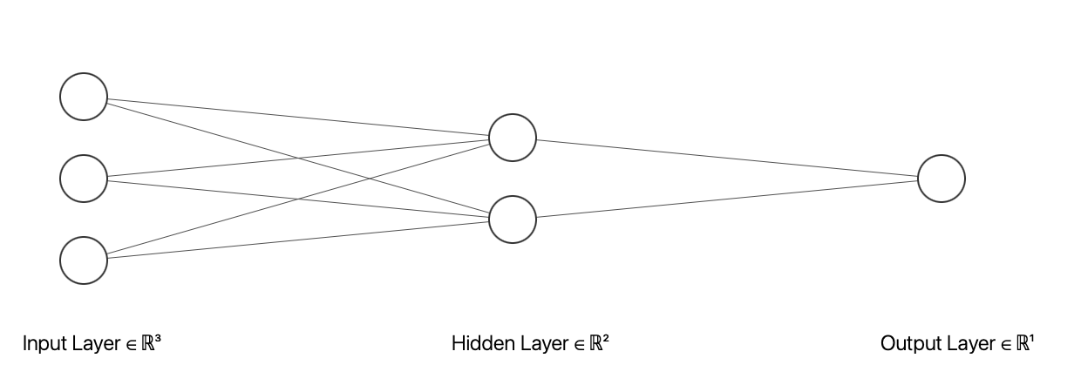
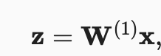
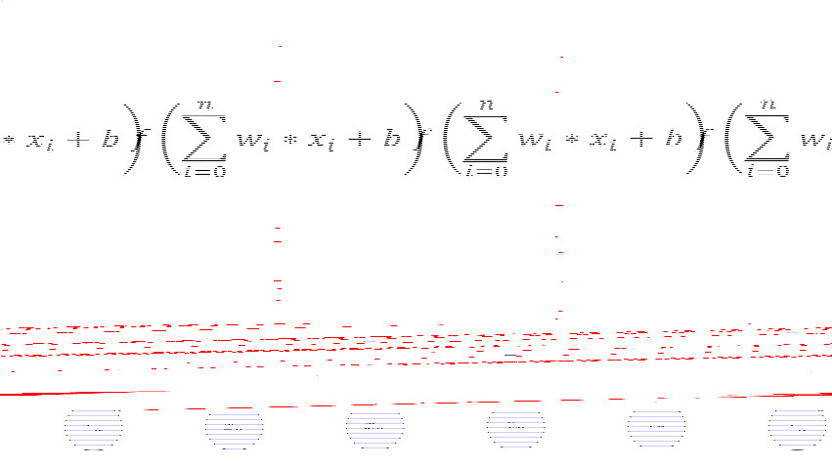
Forward propagation – step 1

Slide 22
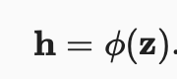

Forward propagation – step 2

Slide 23
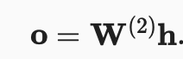

Forward propagation – step 3

Slide 24
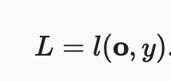
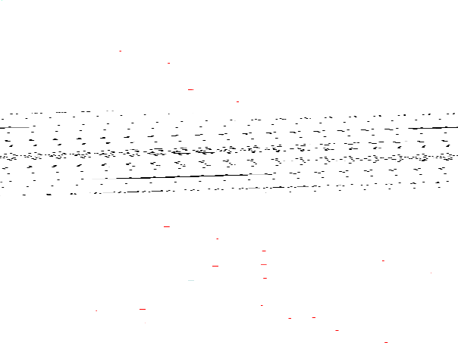
Forward propagation – Loss function (l)

Slide 25

Back propagation
Backpropagation refers to the method of calculating the gradient of neural network parameters.
The method traverses the network in reverse order, from the output to the input layer, according to the chain rule from calculus.
The algorithm stores any intermediate variables (partial derivatives) required during the calculation of the gradient with respect to some parameters.

Slide 26
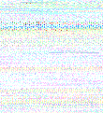
Training a neural network - 1
Often, we start with random weight initialisation.
And then go through multiple iterations applying all the training samples (forward propagation).
Then, calculate the error or loss using a loss function.
After that, we use the error/loss value to update the weights.
We repeat this training iteration several times; in NN terms, each iteration of trying all the training samples in one round is called an “epoch”.

Slide 27
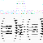
Random initialisation**
If you are interested in the effect of initialisation parameters, see:
https://stackoverflow.com/questions/49433936/how-do-i-initialize-weights-in-pytorch
https://pytorch.org/docs/stable/nn.init.html
Understanding the difficulty of training deep feedforward neural networks, Glorot, X. & Bengio, Y. (2010) https://proceedings.mlr.press/v9/glorot10a/glorot10a.pdf

Slide 28
Training neural networks
In neural network training, forward and backward propagation depend on each other.
In forward propagation, we traverse the computational graph in the direction of dependencies and compute all variables along the path.
These are then used for backpropagation, where the computation order on the graph is reversed.

Slide 29

Training a neural network - 1
Now, the question is how to update the weights to optimise the model and reduce error/loss.
We need a way to calculate the intermediate values for backpropagation and weight updates.
We need a hyperparameter to control the rate of change. This is often done by a hyperparameter called “learning rate”.

Slide 30

Forward propagation – Loss function (l)

Slide 31
Gradient in neural network
Or more precisely, the gradient of neural network parameters.
In backpropagation, we need to calculate the partial derivatives of variables with respect to some parameters.

Slide 32


Derivatives and Differentiation*
A derivative is the rate of change in a function with respect to changes in its arguments.
Derivatives can tell us how rapidly a loss function would increase or decrease if we increase or decrease each parameter by an infinitesimally small amount.

Slide 33

** Example: Calculate the derivative of f(x) = x²

Slide 34

Example - 1

Slide 35



Example - 2
input
1
0.2
y = 0.75 (output/target)
0.1
0.5
0.5
0.3
loss = (y – o)²
0.3
$$z=\left(1×0.2\right)+\left(0.5 × 0.1\right)+\left(0.3 × 0.3\right)=0.34$$
$$h= φ\left(z\right)= ReLU\left(z\right)=ReLU\left(0.34\right)=\max\left(0, 0.34\right)=0.34$$
$$o=0.34 × 0.5=0.17$$
$$l={(0.75−0.17)}^{2}=\text{0.3364}$$

Slide 36


Gradient of the loss function*
T$aking the gradient with regards to \hat{y}$
$$\frac{∂L}{∂\hat{y}}$$
$$L=(y−\hat{y}{\left.)\right.}^{2}$$
Applying the chain rule:
$$\frac{∂}{∂\hat{y}} (y−\hat{y}{\left.)\right.}^{2}=2\left(y−\hat{y}\right)⋅\frac{∂\left(y−\hat{y}\right)}{∂\hat{y}}$$
considering: $\frac{∂\left(y−\hat{y}\right)}{∂\hat{y}}=−1$
Then:
$$\frac{∂L}{∂\hat{y}}=2\left(y−\hat{y}\right)\left(−1\right)=−2\left(y−\hat{y}\right)$$

Slide 37







Example – backpropagation
$$z$$
$$h$$
$$o$$
$$l$$
input
1
w₁₁=0.2
w₁₂=0.1
w₂₁=0.5
y = 0.75 (output)
0.5
w₁₃=0.3
loss = (y- y_predict)
= (y – o)²
0.3
$$grad_{y_{pred}}$$
$$z=\left(1×0.2\right)+\left(0.5 × 0.1\right)+\left(0.3 × 0.3\right)=0.34$$
$$h= φ\left(z\right)= ReLU\left(z\right)=ReLU\left(0.34\right)=\max\left(0, 0.34\right)=0.34$$
$$o=0.34 × 0.5=0.17$$
$$l={(0.75−0.17)}^{2}=\text{0.3364}$$
$$grad_{y_{pred}}=−2 × \left({y− y}_{pred}\right)=− 2 × \left(y −o\right)=−2 × \left(0.75 −0.17\right)=−1.16$$
$\frac{∂L}{∂w_{21}}=h×\frac{∂L}{∂o}=0.34×(−1.16)=−0.3944$
$grad_{h}=w_{21}×\frac{∂L}{∂o}=0.5×(−1.16)=−0.58$
Notes:
∂L​=h×∂o∂L​=0.34×(−1.16)=−0.3944

Slide 38






Example – backpropagation
$$z$$
$$h$$
$$o$$
$$l$$
input
1
w₁₁=0.2
y = 0.75 (output)
w₁₂=0.1
w₂₁=0.5
0.5
w₁₃=0.3
loss = (y- y_predict)
= (y – o)²
0.3
$$grad_{y_{pred}}$$
$$z=\left(1×0.2\right)+\left(0.5 × 0.1\right)+\left(0.3 × 0.3\right)=0.34$$
$$h= φ\left(z\right)= ReLU\left(z\right)=ReLU\left(0.34\right)=\max\left(0, 0.34\right)=0.34$$
$$o=0.34 × 0.5=0.17$$
$$l={(0.75−0.17)}^{2}=\text{0.3364}$$
$$grad_{y_{pred}}=−2 × \left({y− y}_{pred}\right)=− 2 × \left(y −o\right)=−2 × \left(0.75 −0.17\right)=−1.16$$
$\frac{∂L}{∂w_{21}}=h×\frac{∂L}{∂o}=0.34×(−1.16)=−0.3944$
$$\frac{∂L}{∂w_{11}}=x_{1}×\frac{∂L}{∂z}=x_{1}×grad_{h}=0.2× −0.3944=−\text{0}\text{.07888}$$

Slide 39



Example – backpropagation
$$o$$
input
$$z$$
$$h$$
$$l$$
1
w₁₁=0.2
y = 0.75 (output)
w₁₂=0.1
w₂₁=0.5
0.5
w₁₃=0.3
loss = (y – o)²
0.3
$$grad_{y_{pred}}$$
$$z=\left(1×0.2\right)+\left(0.5 × 0.1\right)+\left(0.3 × 0.3\right)=0.34$$
$$h= φ\left(z\right)= ReLU\left(z\right)=ReLU\left(0.34\right)=\max\left(0, 0.34\right)=0.34$$
$$o=0.34 × 0.5=0.17$$
$$l={(0.75−0.17)}^{2}=\text{0.3364}$$
$$grad_{y_{pred}}=−2 × \left({y− y}_{pred}\right)=− 2 × \left(y −o\right)=−2 × \left(0.75 −0.17\right)=−1.16$$
$\frac{∂L}{∂w_{21}}=h×\frac{∂L}{∂o}=0.34×(−1.16)=−0.3944$
$$\frac{∂L}{∂w_{11}}=x_{1}×\frac{∂L}{∂z}=x_{1}×grad_{h}=0.2× −0.3944=−\text{0}\text{.07888}$$
w₁₁ = w₁₁ - grad_w₁₁;
w₁₂ = w₁₂ - grad_w₁₂;
w₁₁ = w₁₁ - grad_w₁₁
w₁₁ = 0.2 – (-0.07888)
= 0.27888

Slide 40

Example – backpropagation
$$o$$
input
$$z$$
$$h$$
$$l$$
1
0.2
y = 0.75 (output)
0.1
0.5
0.5
0.3
loss = (y – o)2
0.3
$$grad_{y_{pred}}$$
$$z=\left(1×0.2\right)+\left(0.5 × 0.1\right)+\left(0.3 × 0.3\right)=0.34$$
$$h= φ\left(z\right)= ReLU\left(z\right)=ReLU\left(0.34\right)=\max\left(0, 0.34\right)=0.34$$
$$o=0.34 × 0.5=0.17$$
$$l={(0.75−0.17)}^{2}=\text{0.3364}$$
$$grad_{y_{pred}}=−2 × \left({y− y}_{pred}\right)=− 2 × \left(y −o\right)=−2 × \left(0.75 −0.17\right)=−1.16$$
$\frac{∂L}{∂w_{21}}=h×\frac{∂L}{∂o}=0.34×(−1.16)=−0.3944$
$$\frac{∂L}{∂w_{11}}=x_{1}×\frac{∂L}{∂z}=x_{1}×grad_{h}=0.2× −0.3944=−\text{0}\text{.07888}$$
w₁₁ = w₁₁ - grad_w₁₁
w₁₁ = 0.2 – (-0.07888)
= 0.27888
w₁₁ = w₁₁ – (learning_rate * grad_w₁₁)
w₁₂ = w₁₂ – (learning_rate * grad_w₁₂)
w₁₃ = w₁₃ – (learning_rate * grad_w₁₃)
w₂₁ = w₂₂ – (learning_rate * grad_w₂₂)

Slide 41

Learning rate
The learning rate is a hyperparameter that controls the change in weights in neural networks based on the gradient.
The learning rate scales the magnitude of weight updates.
For example:
w1 = w1 – (learning_rate * grad_w1)
w2 = w2 – (learning_rate * grad_w2)

Slide 42

How to choose a learning rate
There are various ways to choose and optimise the learning rate.
A simple approach is to start with a relatively large value (e.g. 0.01 or 0.1) and then (exponentially) reduce it over iterations.
With dynamic learning rates, if the learning rate decreases too rapidly, it can affect network convergence (i.e., finding an optimal solution).
If (a large) learning rate changes too slowly, the network may fail to converge to a good enough solution since noise (noise in samples that causes noisy gradients) could keep on driving the network away from an optimal solution.

Slide 43


Exploding and vanishing gradients*
- The objective function for highly nonlinear deep neural networks or recurrent neural networks often contains sharp nonlinearities in parameter space resulting from the multiplication of several parameters.
- These nonlinearities give rise to very
high derivatives in some places.
- When the parameters get close to such a cliff region, a gradient descent update can catapult the parameters very far, possibly losing most of the optimisation work that has been done.
Source: Adapted from Goodfellow et al., Deep Learning, MIT Press, https://www.deeplearningbook.org/contents/optimization.html
Original figure from (Pascanu et al., 2013)

Slide 44


Momentum
While stochastic gradient descent remains a popular optimisation strategy, learning with it can sometimes be slow. The momentum method (Polyak, 1964) was designed to accelerate learning.
The momentum algorithm accumulates an exponentially decaying moving average of past gradients and continues moving in that direction.
Formally, the momentum algorithm introduces a variable $v$ that plays the role of velocity: it specifies the direction and speed at which the parameters move through parameter space.
Goodfellow et al., Deep Learning, MIT Press, https://www.deeplearningbook.org/contents/optimization.html

Slide 45


SGD*
Source: Goodfellow et al., Deep Learning, MIT Press, https://www.deeplearningbook.org/contents/optimization.html

Slide 46


SGD with momentum
Source: Goodfellow et al., deep Learning, https://www.deeplearningbook.org/contents/optimization.html

Slide 47




Momentum*
If $α=0,$ the momentum acts like a normal gradient descent:
An example with a non-zero $α:$
Source: Goodfellow et al., deep Learning, https://www.deeplearningbook.org/contents/optimization.html

Slide 48
Algorithms with adaptive learning rate
The AdaGrad algorithm adapts the learning rates of all model parameters by scaling them inversely proportional to the square root of the sum of the historical squared gradients (Duchi et al., 2011).
Source: Adapted from Goodfellow et al., Deep Learning, MIT Press, https://www.deeplearningbook.org/contents/optimization.html

Slide 49

RMSProp
The RMSProp algorithm (Hinton, 2012) modifies AdaGrad to perform better in the nonconvex setting by replacing gradient accumulation with an exponentially weighted moving average.
AdaGrad shrinks the learning rate according to the entire history of the squared gradient and may have made the learning rate too small before arriving at such a convex structure.
RMSProp uses an exponentially decaying average to discard history from the distant past, allowing it to converge rapidly.
It has a decay rate parameter.
Source: Adapted from Goodfellow et al., Deep Learning, MIT Press, https://www.deeplearningbook.org/contents/optimization.html

Slide 50

Adam
Adam (Kingma and Ba, 2014) is another adaptive learning rate optimisation algorithm.
The name “Adam” derives from the phrase “ADAptive Moments.”
In Adam, momentum is incorporated directly as an estimate of the ﬁrst-order moment (with exponential weighting) of the gradient.
The simplest way to add momentum to RMSProp is to apply it to the rescaled gradients.
Adam includes bias corrections to the estimates of both the ﬁrst-order moments (the momentum term) and the (uncentered) second-order moments to account for their initialisation at the origin.
Source: Adapted from Goodfellow et al., Deep Learning, MIT Press, https://www.deeplearningbook.org/contents/optimization.html

Slide 51
Adam*
Adam uses exponential weighted moving averages (also known as leaky averaging) to obtain an estimate of both the momentum and the second moment of the gradient.

Slide 52


Adam**
Source: Adapted from Goodfellow et al., Deep Learning, MIT Press, https://www.deeplearningbook.org/contents/optimization.html

Slide 53


Adam**
Same as the previous slide with just different notations to show the variables and parameters.
See: https://pytorch.org/docs/stable/generated/torch.optim.Adam.html

Slide 54

How to choose the number of hidden layers
This depends on the complexity of the data and the decision boundaries (i.e. how separable the data is).
This could also depend on the number of features/dimensions.
A very basic recommendation is that 2 to 3 hidden layers be used for less complex problems, and 3 to 5 hidden layers be used for more complex problems.
Several deep learning architectures use more layers. The more layers you add, the more hyperparameters you need to train and optimise. This complexity would impact your network's convergence (and overfitting).
The number of neurons in hidden layers is also important (width) of the network.

Slide 55

Dropouts
Dropout is a regularisation technique to reduce the risk of overfitting in neural networks.
In neural networks, it refers to temporarily dropping input and hidden layer nodes.
This creates a new temporary architecture by randomly dropping a percentage of nodes during the training process.

Slide 56
Dropout – philosophy
A key idea behind applying dropout is that training a neural network by adding a stochastic behaviour and making predictions, and averaging over multiple stochastic decisions simulates a form of bagging with parameter sharing.
In Bagging (i.e., bootstrap aggregation), several models are combined to reduce the generalisation error.
The idea of Bagging is to train multiple models separately and then use all the models to vote on the output for the test example.

Slide 57

Dropouts – practical notes
When the training sample is very small, the dropout method is not very effective.
When additional unlabeled samples are available, unsupervised feature learning can improve performance better than dropout.

Slide 58


Example

Slide 59

Open discussion
You’re training an MLP to predict stroke risk from patient data (age, blood pressure, imaging features). The network has multiple hidden layers and uses ReLU activations.
Gradient Flow:
How do optimisers like SGD, Momentum, and Adam affect convergence speed and stability in deep MLPs?
What happens if gradients vanish or explode during training?
Learning Rate Scheduling:
Why is a fixed learning rate problematic for MLPs?
How do adaptive methods (Adam, RMSProp) compare to scheduled decay?
Regularisation and Generalisation:
How do dropout and weight decay interact with optimiser behaviour?
Can an optimiser compensate for poor regularisation choices?

Slide 60
Review questions

Slide 61

Q1
What could be the purpose of a NN architecture like this?

Slide 62
Q2
Which of these will not improve the convergence of a neural network model?
Adaptive learning rate
Data normalisation
Using an optimiser method
Initialising all the weights to zero (zero initialisation)

Slide 63
Acknowledgments
Some of the slides are adapted from Dive into Deep Learning by Aston Zhang et al., https://d2l.ai/index.html

Slide 64
If you have any questions
Please feel free to arrange a meeting or email (p.barnaghi@imperial.ac.uk).
My office: 928, Sir Michael Uren Research Hub, White City Campus.

Slide 65
Further reading

Slide 66



Derivative of Sigmoid function
If you are interested in the proof of how this is derived, see:
Lin (2019, Jan. 12). Data science: Data science tutorials.
https://hausetutorials.netlify.app/posts/2019-12-01-neural-networks-deriving-the-sigmoid-derivative/
For more information on $ex$ derivative, see:
http://www.intuitive-calculus.com/derivative-of-e-x.html
Source for the formula: Dive into Deep Learning by Aston Zhang et al., https://d2l.ai/index.html

Slide 67

Gradient of ReLU
$$gradient of ReLU=\frac{∂ReLU(x)}{∂x}= \left\{\begin{aligned}0 if x<0 \\ 1 if x>0 \end{aligned}\right.$$
For other gradients and an excellent summary, you can refer to the blog post by by Andrew Wood at:
https://aew61.github.io/blog/artificial_neural_networks/1_background/1.b_activation_functions_and_derivatives.html
Source for the formula: Dive into Deep Learning by Aston Zhang et al., https://d2l.ai/index.html

Slide 68


Random initialisation**
$Pytorch$ return the recommended gain value for the given nonlinearity function.
According to the method described in Understanding the difficulty of training deep feedforward neural networks, Glorot, X. & Bengio, Y. (2010), using a uniform distribution. The resulting tensor will have values sampled from $U(−a,a)$ where (also known as Glorot initialisation):
f$an_in and fan_out$:
https://stackoverflow.com/questions/42670274/how-to-calculate-fan-in-and-fan-out-in-xavier-initialization-for-neural-networks
Source: https://pytorch.org/docs/stable/nn.init.html

Slide 69


Newton’s method**
Newton’s method is an optimisation scheme based on using a second-order Taylor series expansion to approximate $J(θ)$ near some point $θ0$ignoring derivatives a of higher order:
Where $H$ is the $Hessian$ of $J$ with respect to θ evaluated at θ₀ If we then solve for the critical point of this function, we obtain the Newton parameter update rule:
Source: Adapted from Goodfellow et al., deep Learning, https://www.deeplearningbook.org/contents/optimization.html
For more information see Chapter 8 of Goodfellow et al.’s book.

Slide 70

Newton’s method – the algorithm
If the objective function is convex but not quadratic (there are higher-order terms), this update can be iterated, yielding the training algorithm associated with Newton’s method, given in algorithm
Source: Adapted from Goodfellow et al., Deep Learning, MIT Press, https://www.deeplearningbook.org/contents/optimization.html

Slide 71

The $Hessian$Matrix ($H$)
For more information on the Hessian matrix and how to derive it, see:
https://www.khanacademy.org/math/multivariable-calculus/applications-of-multivariable-derivatives/quadratic-approximations/a/the-hessian

